Slide 1
BIT 1103 Fundamentals of Information Systems
Information System cycle

Slide 2
Learning Objectives
Understand Information System cycle
Understand the system development life cycle (SDLC)
Understand Information Processing Cycle-Phases
Understand alternative approaches to system development

Slide 3
Information Systems Processing phases
Information Systems Processing phases
Input
  Data Acquisition
  Data Preparation
Processing
Storage
Output
Distribution /dissemination

Slide 4
Information Processing Cycle
These are the steps that are taken to convert raw facts, which is data, into information. Information processing cycle is a sequence of events consisting of input, processing, storage & output.
For a computer to perform useful work, the computer has to receive instructions and data from the outside world.
The computer receives data and instructions during the INPUT stage of the information processing cycle.
Useful information or results are got when appropriate instructions are applied to data. Applying instructions to data takes place during the PROCESSING stage of the information processing cycle.
To avoid re-entering data and instructions or reprocess information, computers can save information.
Saving information on a computer occurs during the STORAGE phase of the information processing cycle. This is followed by the result in the OUTPUT stage.

Slide 5
Data Processing
Data processing is simply the conversion of raw data to meaningful information through a process. Data is manipulated to produce results that lead to a resolution of a problem or improvement of an existing situation.
Similar to a production process, it follows a cycle where inputs (raw data) are fed to a process (computer systems, software, etc.) to produce output (information and insights).
Generally, organizations employ computer systems to carry out a series of operations on the data in order to present, interpret, or obtain information. The process includes activities like data entry, summary, calculation, storage, etc. Useful and informative output is presented in various appropriate forms such as diagrams, reports, graphics, etc.

Slide 6
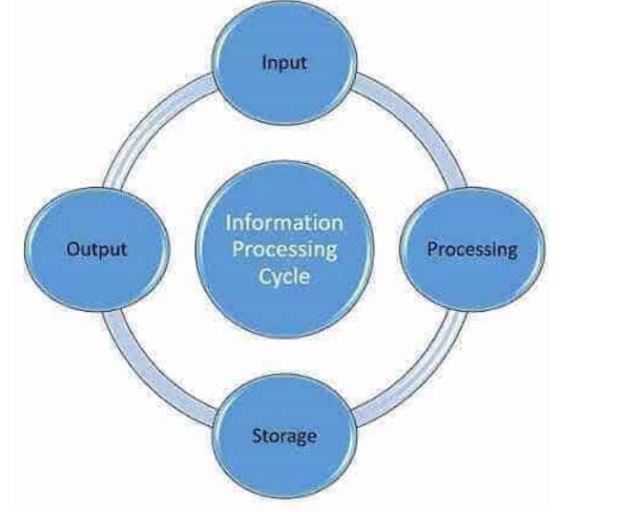
Information Processing Cycle-Phases
Distribution /dissemination

Slide 7
Input
Input is defined as the entering of data into the computer or feeding the collected raw data in the cycle for processing. This is the raw data which is supplied for processing & obtaining information.
In this phase the computer receives data from input source by user or a program.
Users input data or instruction into the computer system to be processed. The Inputs could be either text, graphic, audio or video. Input devices are any electronic device connected to a computer and produces input signals.
Input can be done by utilizing various devices such as keyboards, mice, scanners, barcode readers, joysticks, digital data tablets (for graphics drawing), electronic cash registers, e.t.c
The input stage can be further broken down into acquisition, data entry and validation.

Slide 8
Input
Data acquisition is defined as the process of collecting and organizing information.
An example of data acquisition is taking a survey to identify the people's position on an issue, which can then be analyzed.
Data entry is the process of inputting data or information into the computer using devices such as a keyboard, scanner,
Data validation is the process of ensuring data have undergone data cleansing to ensure they have data quality, that is, that they are both correct and useful

Slide 9
Processing
Processing refers to performing actions on data entered into an information system. Once the input is provided the raw data is processed by a suitable or selected processing method. This is the most crucial step as it allows for the processed data in the form of output which will be used further.
Data or instruction being input into the computer system is then processed by the CPU which controls all activities within the system. The results of the processed data are then sent to an output device as usable data. A CPU interprets and carries out the instructions by processing data and controlling the rest of the computer’s components.

Slide 10
Storage
Storage is the process of Saving data in a soft/physical form. Computer storage is important to help users store programs and data to be used at a later time. It is also useful to keep current data while being processed by the processor until the information is saved in a storage media such as a hard disk. Computer storage also stores instructions from a computer program.
There are two type of computer storage; primary storage and secondary storage.
Primary storage is known as the main memory of a computer, including RAM (Random-Access Memory) and ROM (Read-Only Memory). It is an internal memory (inside the system Unite) that can be accessed directly by the processor.

Slide 11
Output
Output is the stage where processed information is now transmitted to the user. Output is presented to users in various report formats like printed report, audio, video, or on monitor. Output need to be interpreted so that it can provide meaningful information that will guide future decisions of the company.
Output is the result of data processing activity when it is presented to the external system. There are four types of output, which are texts, graphics, audio and video
This can be used as it is or used for further processing along with more data.

Slide 12
Information Distribution
Information distribution refers to the processes through which individuals, groups, or different units of the organization share data and information among themselves. This can be achieved over networked systems.

Slide 13
Information Systems Projects
Where do information Systems Projects Originate?
New or changed IS development projects come from problems, opportunities, and directives, and are always subject to one or more constraints.
Most maintenance of existing IS projects come from users discovering real problems with existing IS.

Slide 14
Where do information Systems Projects Originate?
Problems – may either be current, suspected, or anticipated. Problems are undesirable situations that prevent the business from fully achieving its purpose, goals, and objectives.

Slide 15
Where do information Systems Projects Originate?
2. An Opportunity – is a chance to improve the business even in the absence of specific problems. This means that the business is hoping to create a system that will help it to increase its revenue, profit and services or decrease its cost.

Slide 16
Where do information Systems Projects Originate?
3. A Directive – is a new requirement that is imposed by management, government, or some external influence
Constraints are limitations and compromises
that come with the soon to be developed IS.
Notes:
Constraints : schedule, budget, Team composition and make, software licensing restrictions/requirement.

Slide 17
Information Systems Development
In systems engineering and information systems, the systems development life cycle/the application development life-cycle, is a process for planning, creating, testing, and deploying an information system.
The systems development life cycle is a systematic approach to solving business problems.
Describes seven phases required to develop an IT system, from an initial feasibility study through maintenance of the completed application.
It is divided into seven phases.
Each phase has unique activities.

Slide 18
The Need for Structured Systems Development
Options for Obtaining Information Systems
  Build your own
  Buy a prepackaged system from a software development company or consulting firm. Example: Payroll system.
  Outsource development to a 3rd party: Good option when an organization does not have adequate resources or expertise.
  End-user development: Individual users and departments build their own custom systems to support their individuals.

Slide 19
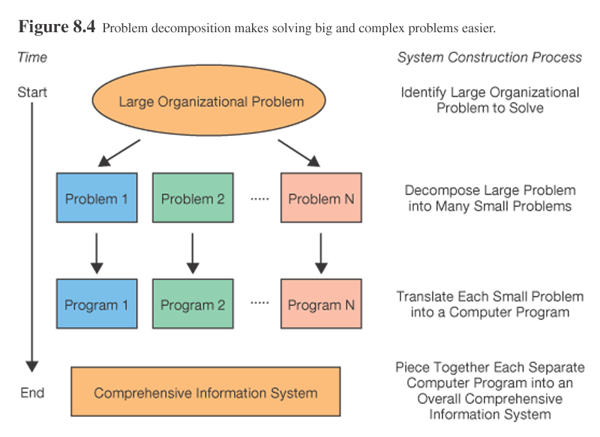
The Need for Structured Systems Development

Slide 20
The Need for Structured Systems Development
The Role of Users in the Systems Development Process
  It is important for all members of the organization to understand what is meant by system development and what activities occur.
  Effective partnership: A close and mutually respectful working relationship between analysts and users is a key to project success.

Slide 21
The Need for Structured Systems Development
Systems analysis and design – the process of designing, building, and maintaining information systems
  The individual who performs this task is called Systems analyst
  Organization wants to hire System analyst because they have both technical and managerial expertise.

Slide 22
SYSTEMS DEVELOPMENT LIFE CYCLE (SDLC)
SDLC - is defined as a structured step-by-step approach for developing information systems
Typical activities include:
    Determining budgets
    Gathering business requirements
    Designing models
    Writing user documentation

Slide 23
SYSTEMS DEVELOPMENT LIFE CYCLE (SDLC)
SDLC PHASE | ACTIVITIES
Planning | Define the system to be developed Set the project scope Develop the project plan
Analysis | Gather business requirements
Design | Design the technical architecture Design system models
Development | Build technical architecture Build databases and programs
Testing | Write test conditions Perform testing
Implementation | Write user documentation Provide training
Maintenance | Build a help desk Support system changes

Slide 24
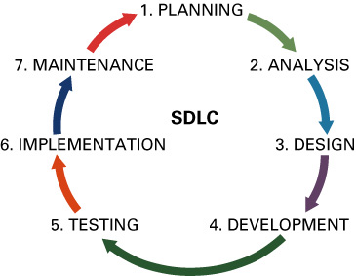
The SDLC has 7 phases:
  Planning
  Analysis
  Design
  Development
  Testing
  Implementation
  Maintenance

Slide 25
Phase 1: Planning
Planning phase - involves determining a solid plan for developing your information system. The planning sometimes referred to as feasibility study involves the following tasks
Define the problem and scope of existing system.
Overview of the new system and determine its objectives.
Confirm project feasibility and produce the project Schedule.
During this phase, threats, constraints, integration and security of system are also considered.
A feasibility report for the entire project is created at the end of this phase.

Slide 26
Phase 1: Planning
There are three primary planning activities:
  Define the system to be developed
    Critical success factor (CSF) - a factor simply critical to your organization’s success
  Set the project scope
    Project scope - clearly defines the high-level system requirements
    Scope creep - occurs when the scope of the project increases
    Feature creep - occurs when developers add extra features that were not part of the initial requirements
    Project scope document - a written definition of the project scope and is usually not longer than a paragraph

Slide 27
Phase 1: Planning
  Develop the project plan including tasks, resources, and timeframes
    Project plan - defines the what, when, and who, questions of system development
    Project manager - an individual who is an expert in project planning and management, defines and develops the project plan and tracks the plan to ensure all key project milestones are completed on time
    Project milestones - represent key dates for which you need a certain group of activities should be performed

Slide 28
Phase 2: Analysis
Analysis phase - involves end users and IT specialists working together to gather, understand, and document the business requirements for the proposed system
This phase involves the following tasks
Gather, analyze, and validate the information.
Define the requirements and prototypes for new system.
Evaluate the alternatives and prioritize the requirements.
Examine the information needs of end-user and enhances the system goal.
A Software Requirement Specification (SRS) document, which specifies the software, hardware, functional, and network requirements of the system is prepared at the end of this phase

Slide 29
Phase 2: Analysis
Two primary analysis activities:
  Gather the business requirements
    Business requirements - the detailed set of knowledge workers requests that the system must meet in order to be successful
    Joint application development (JAD) - knowledge workers and IT specialists, meet sometimes for several days, to define or review the business requirements for the system
  Prioritize the requirements
    Requirements definition document – prioritizes the business requirements and places them in a formal comprehensive document

Slide 30
Phase 3: Design
Design phase - build a technical blueprint of how the proposed system will work .The following are important during design phase
Includes the design of application, network, databases, user interfaces, and system interfaces.
Transform the SRS document into logical structure, which contains detailed and complete set of specifications that can be implemented in a programming language.
Create a possibility, training, maintenance, and operation plan.
Review the proposed design. Ensure that the final design must meet the requirements stated in SRS document.
Finally, prepare a design document which will be used during next phases.

Slide 31
Phase 3: Design
Two primary design activities:
  Design the technical architecture
    Technical architecture - defines the hardware, software, and telecommunications equipment required to run the system
  Design system models
    Modeling - the activity of drawing a graphical representation of a design
    Graphical user interface (GUI) - the interface to an information system
    GUI screen design - the ability to model the information system screens for an entire system

Slide 32
Phase 4: Development
Development phase - take all of your detailed design documents from the design phase and transform them into an actual system
Two primary development activities:
  Build the technical architecture
  Build the database and programs
    Both of these activities are mostly performed by IT specialists

Slide 33
Phase 5: Testing
Testing phase - verifies that the system works and meets all of the business requirements defined in the analysis phase
Two primary testing activities:
  Write the test conditions
    Test conditions - the detailed steps the system must perform along with the expected results of each step

Slide 34
Phase 5: Testing
  Perform the testing of the system
    Unit testing – tests individual units of code
    System testing – verifies that the units of code function correctly when integrated
    Integration testing – verifies that separate systems work together
    User acceptance testing (UAT) – determines if the system satisfies the business requirements

Slide 35
Phase 6: Implementation
Implementation phase - distribute the system to all knowledge workers and they begin using the system to perform their everyday jobs . In this phase the following tasks are done.
Implement the design into source code through coding.
Combine all the modules together into training environment that detects errors and defects.
A test report which contains errors is prepared through test plan that includes test related tasks such as test case generation, testing criteria, and resource allocation for testing.
Integrate the information system into its environment and install the new system

Slide 36
Phase 6: Implementation
Two primary implementation activities
  Write detailed user documentation
    User documentation - highlights how to use the system
  Provide training for the system users
    Online training - runs over the Internet
    Workshop training - is held in a classroom environment and lead by an instructor

Slide 37
System Implementation
  Implementation method
    Parallel -use both the old and new system simultaneously
    Direct -discard the old system completely and use the new
    Phased -implement the new system in phases
    Experimental(Pilot) - start with small groups of people on the new system and gradually add more users
  System documentation, training, and support
    User and reference guides
    Training and tutorials
    Installation procedures and troubleshooting guides
Notes:
An organization can only work on only a limited number of projects at a given time due to limited resources so care must be taken when selecting the projects to build.
After all possible projects are identified, those deemed most likely to yield significant organizational benefits, given available resources, are selected for subsequent development.
Some possible evaluation criteria for ranking potential projects are: strategic alignment, potential benefits, potential costs and resource availability, project size and duration, and technical difficulty.

Slide 38
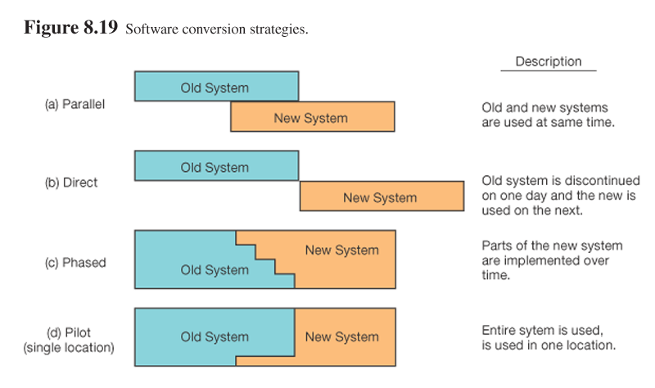

Slide 39
Phase 7: Maintenance & Support
Maintenance phase - monitor and support the new system to ensure it continues to meet the business goals .
Include all the activities such as phone support or physical on-site support for users that is required once the system is installing.
Implement the changes that software might undergo over a period of time, or implement any new requirements after the software is deployed at the customer location.
It also includes handling the remaining errors and resolve any issues that may exist in the system even after the testing phase.
Maintenance and support may be needed for a longer time for large systems and for a short time for smaller systems

Slide 40
There two primary maintenance activities under the Phase of Maintenance & Support
  Build a help desk to support the system users
    Help desk - a group of people who responds to knowledge workers’ questions
  Provide an environment to support system changes

Slide 41
Systems disposition
This phase represents the end of the system's life cycle. It provides for the systematic termination of a system to ensure that vital information is preserved for potential future access and/or reactivation.
The system, when placed in the Disposition Phase, it means it has been declared obsolete and has been scheduled for shutdown.
The emphasis of this phase is to ensure that the system is packaged and disposed off in accordance with appropriate regulations and requirements.

Slide 42
Reasons why software development projects fail
Scope being too broad or too narrow
Lack of needed skills
Incomplete specifications/ Unclear requirements
Lack of management/user involvement
Poor Communication
Resistance to change
Not reviewing project progress on a regular basis
Unrealistic expectations
The absence of a good project manager
Working without purpose
Moving the goalposts too often
Not investing enough time and money in your team
Over-promising just to close the deal

Slide 43
Read about software development methodologies
Water fall
Agile
Iterative
Prototyping
Rapid Application Development Approach
incremental
Spiral Model
Joint Application Development
Phased development methodology

Slide 44
Review Questions
1. List and describe the major stages of the systems development life cycle.
2. What is prototyping and what advantages does it offer in the SDLC?
3. Explain why the investigation phase, the initial analysis, and the design phases are the most critical stages of the SDLC.
4. Explain the systems life cycle and describe why this concept is important to systems developers.
5. Explain the system development methodologies

Slide 45
Review Questions
Describe the role of a systems analyst in the systems development process.
Discuss the importance of recognising system features and system boundaries as it relates to systems development.
Describe and differentiate at least four different system types which fall under the umbrella of ‘information systems’.

Slide 46

Thank You
!!!!!!!!!!!

